Slide 1
How We Securely Scaled Multi-Tenancy with vcluster, Crossplane, and Argo CD
Kubecon 2023 Amsterdam

Slide 2


Your hosts
Ilia Medvedev
DevOps Engineer - Codefresh
Kostis Kapelonis
Developer Advocate - Codefresh
Notes:
Equivalent features - coming to CSDP soon

Slide 3

Let’s set the stage
Provide hosted Argo CD to the masses?

Slide 4

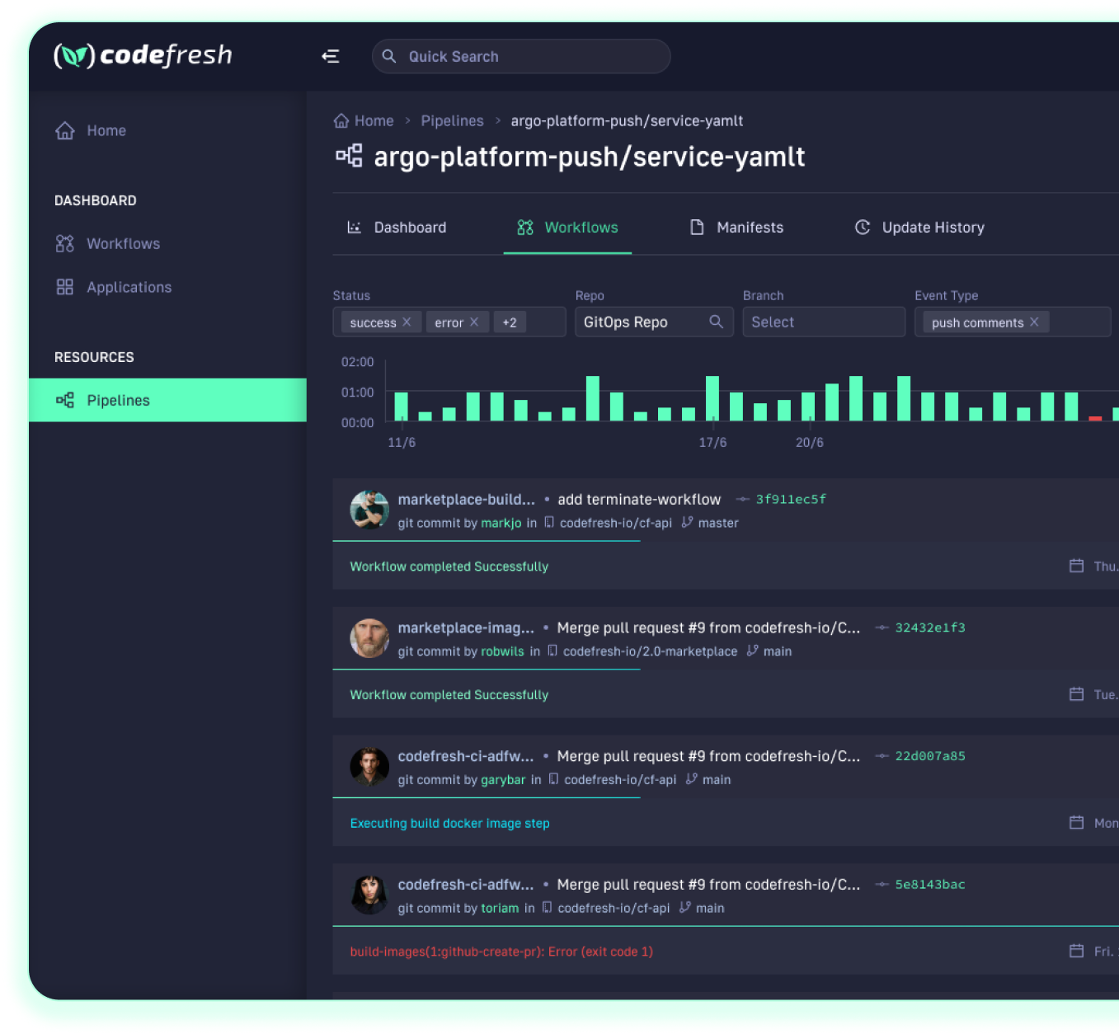

About Codefresh
Modern Deployment Platform
Comes with CI, CD and GitOps modules
Enterprise Ready
Code-to-cloud visibility across apps and clusters
Continuous Delivery
Progressive delivery without compromising stability powered by Argo CD and Argo Rollouts

Slide 5
Goals
Allow customers to sign-up
Offer an Argo CD instance to EACH customer account
SAAS platform is open to anybody
We don’t know the number of users in advance
Essentially we want hosted Argo CD instances
Notes:
Equivalent features - coming to CSDP soon

Slide 6
Meme without a pictureTM
“ You get an Argo CD instance, you get an Argo CD instance, everybody gets their own Argo CD instance”
Notes:
Equivalent features - coming to CSDP soon

Slide 7
Options, Options, Options
Possible solutions

Slide 8
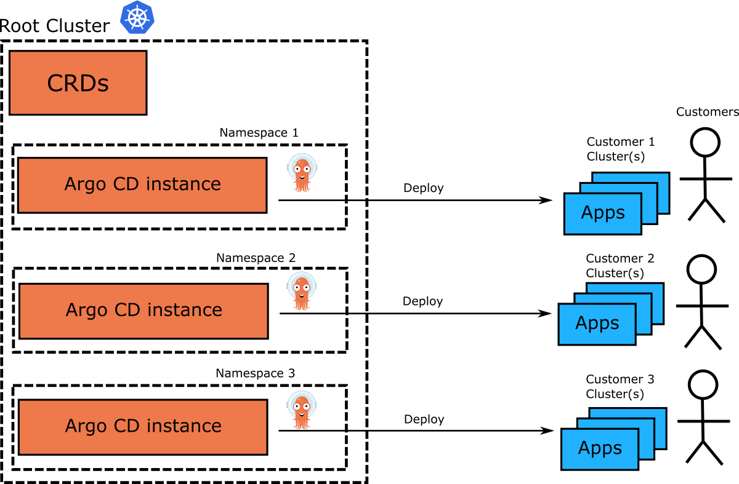
Argo CD per namespace
Notes:
Equivalent features - coming to CSDP soon

Slide 9
Single cluster to house all Argo CD instances
Centralized management ✅
Resource efficient ✅
Fast setup (namespace based) ✅
Need to setup policies/quotas/isolation ❌
“Noisy neighbor” issues ❌
Argo CD itself has CRDs ❌
Same cluster version for everybody ❌
Notes:
Equivalent features - coming to CSDP soon

Slide 10
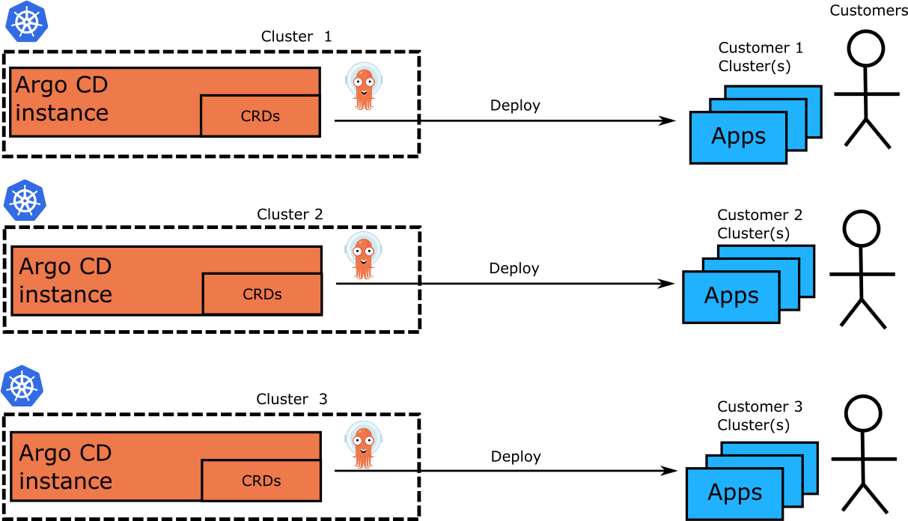
Argo CD per cluster
Notes:
Equivalent features - coming to CSDP soon

Slide 11
New cluster per account
Total isolation ✅
Different cluster version per customer ✅
No issues with Argo CD CRDs ✅
Cloud cost issues❌
Slow to setup (wait for new cluster) ❌
Difficult management ❌
Notes:
Equivalent features - coming to CSDP soon

Slide 12
Single cluster/multiple ns
Multiple clusters
✅ - Centralized management
✅ - Cost Effective
✅ - Common resources
✅ - Fast init
❌- No isolation
❌- Tenant confined to namespace
❌- Same K8s version for everybody
❌- CRDs hard to handle
❌- Resource starvation
✅ - Great isolation
✅ - Full cluster access for tenant
✅ - No issues with CRDs
✅ - K8s version flexibility
❌ - Complex management ❌ - Expensive
❌ - No Resource sharing
❌ - Slow init

Slide 13
What about Security?
Argo CD has network access to target deployment clusters (including production)
Compromising Argo CD could compromise production
Tenants should never get access to other Argo CD instances than their own
Notes:
Equivalent features - coming to CSDP soon

Slide 14
New kid on the block
Enter Virtual cluster

Slide 15

Virtual Kubernetes clusters
vcluster.com
Open source project by Loft Labs
Cluster within a cluster
Fully Kubernetes compliant
Notes:
Equivalent features - coming to CSDP soon

Slide 16
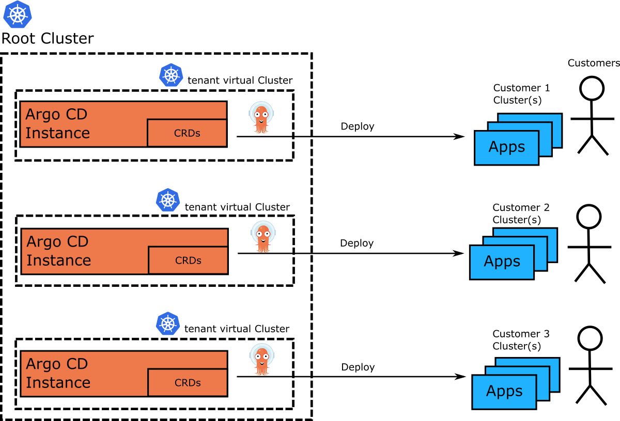
Virtual Kubernetes clusters
Notes:
Equivalent features - coming to CSDP soon

Slide 17
Get the best of both worlds
✅ - Good isolation
✅ - Full cluster access for tenant
✅ - Cost effective
✅ - No issues with CRDs
✅ - Centralized management
✅ - Common resources
✅ - Fast init
✅ - K8s Version flexibility
❌ - Some hardening required ❌ - Host cluster is SPF
Notes:
Equivalent features - coming to CSDP soon

Slide 18
Implementation

Slide 19
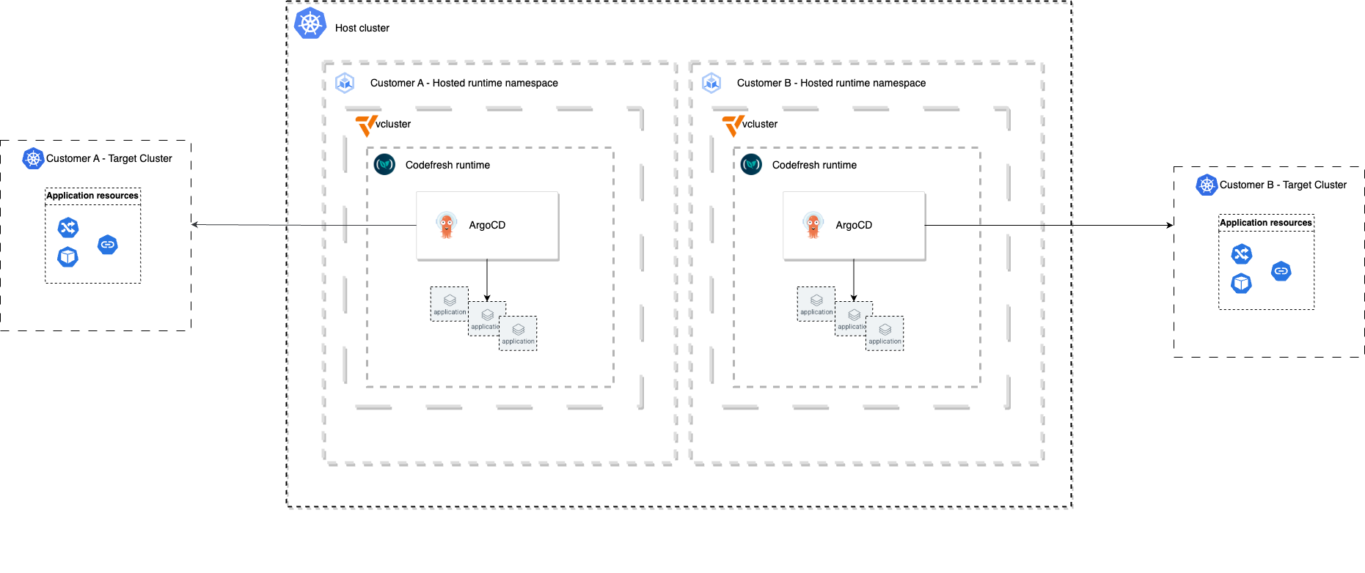
Solution Architecture
Notes:
Equivalent features - coming to CSDP soon

Slide 20

vcluster concepts
vclusters are deployed on the host cluster just like any other workload- using plain manifests or a Helm chart.
vclusters are entirely namespace scoped hence their installation does not require cluster admin privileges.
High level resources are virtual (Deployments, Statefulsets,CRD’s)
Low level resources that are required for workloads to run are synced to the host (Pods, Secrets, etc)
Notes:
Equivalent features - coming to CSDP soon

Slide 21
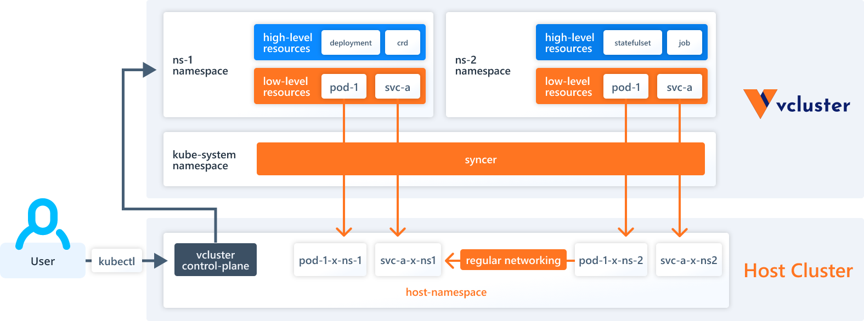
https://www.vcluster.com/docs/architecture/basics
Notes:
Equivalent features - coming to CSDP soon

Slide 22
Scaling and automation
To deploy a single Argo CD instance (Codefresh runtime) we need to:
Deploy vcluster Helm chart
Deploy the runtime workloads onto the vcluster - Also using Helm.
The challenge - Since vcluster has its own Kube API, it’s not as simple as deploying workloads to the same cluster.
Maybe we should treat vcluster as a piece of infrastructure, and consider tools that belong to infrastructure provisioning domains?
Notes:
Equivalent features - coming to CSDP soon

Slide 23


Enter Crossplane
Kubernetes native.
Manages non-Kubernetes resources using Kubernetes CRD’s. Even pizza orders!
Crossplane utilizes Kubernetes control loops to serve as a general purpose control plane that among other things can be used for infrastructure provisioning and lifecycle.
Notes:
Equivalent features - coming to CSDP soon

Slide 24
Provisioning infra with crossplane
To provision infrastructure with crossplane we use providers and resources:
Resources - Are represented using Kubernetes CRD’s and describe the resource we want to provision.
Providers - Are Kubernetes controllers that manage those resources and provision the infrastructure by invoking 3rd party API’s
Provider config - Defines how the provider should create resources. For example which credentials to use against the infrastructure provider.
Notes:
Equivalent features - coming to CSDP soon

Slide 25
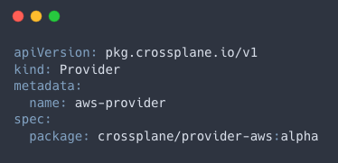
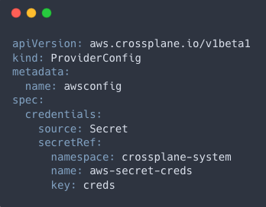
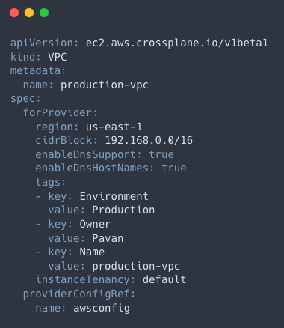
Crossplane example - AWS VPC

Slide 26
Crossplane composition
One of the most powerful features of Crossplane is the ability to create composite resources. Composite resources may utilize multiple provisioners.
Create your own CRD and reuse existing controllers.
An example of such use case would be to provision a GKE cluster using GCP provider and once the cluster is deployed use Kubernetes provider to deploy ArgoCD onto the cluster.
https://github.com/crossplane-contrib/provider-kubernetes/blob/main/examples/in-composition/composition.yaml
Notes:
Equivalent features - coming to CSDP soon

Slide 27


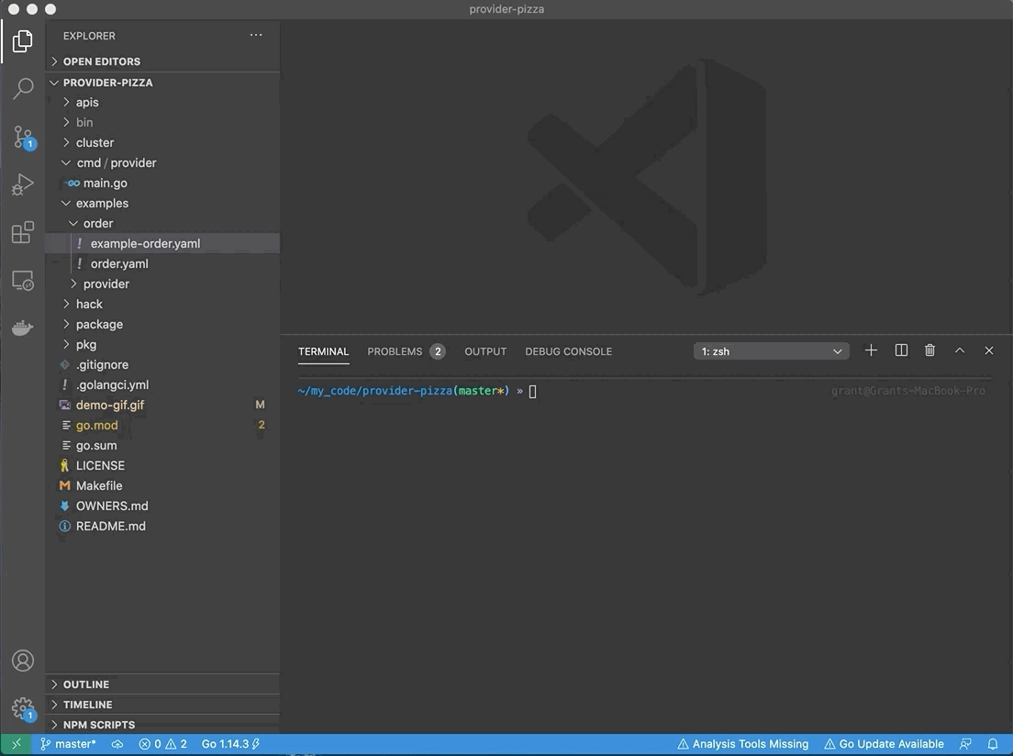
Learn how to order a pizza with Crossplane!
Notes:
Equivalent features - coming to CSDP soon

Slide 28
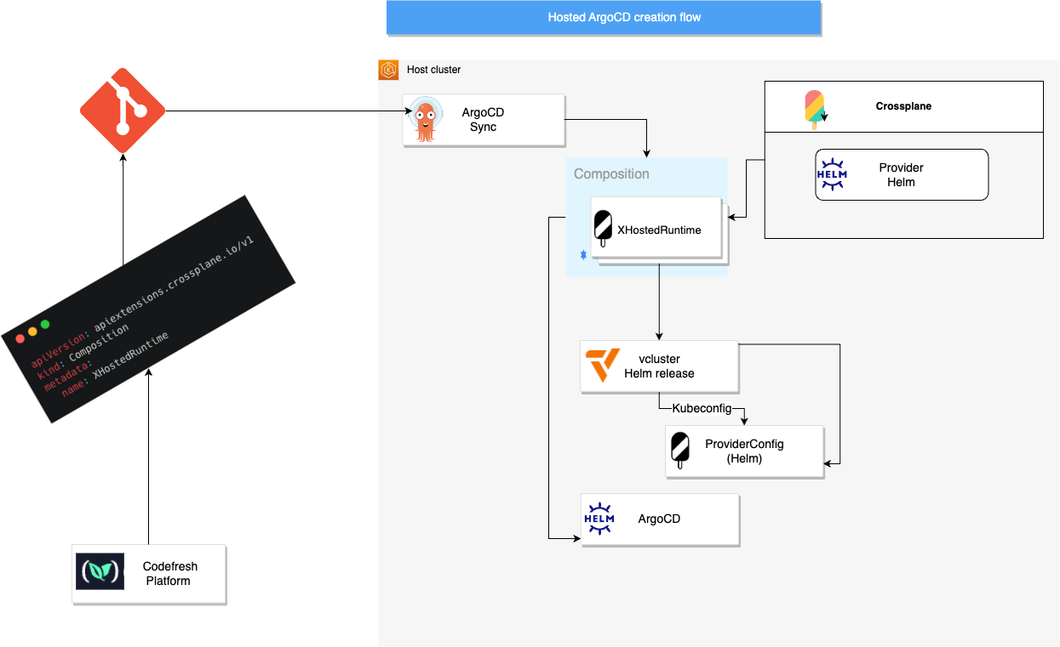
Notes:
Equivalent features - coming to CSDP soon

Slide 29
How it looks
End user experience

Slide 30
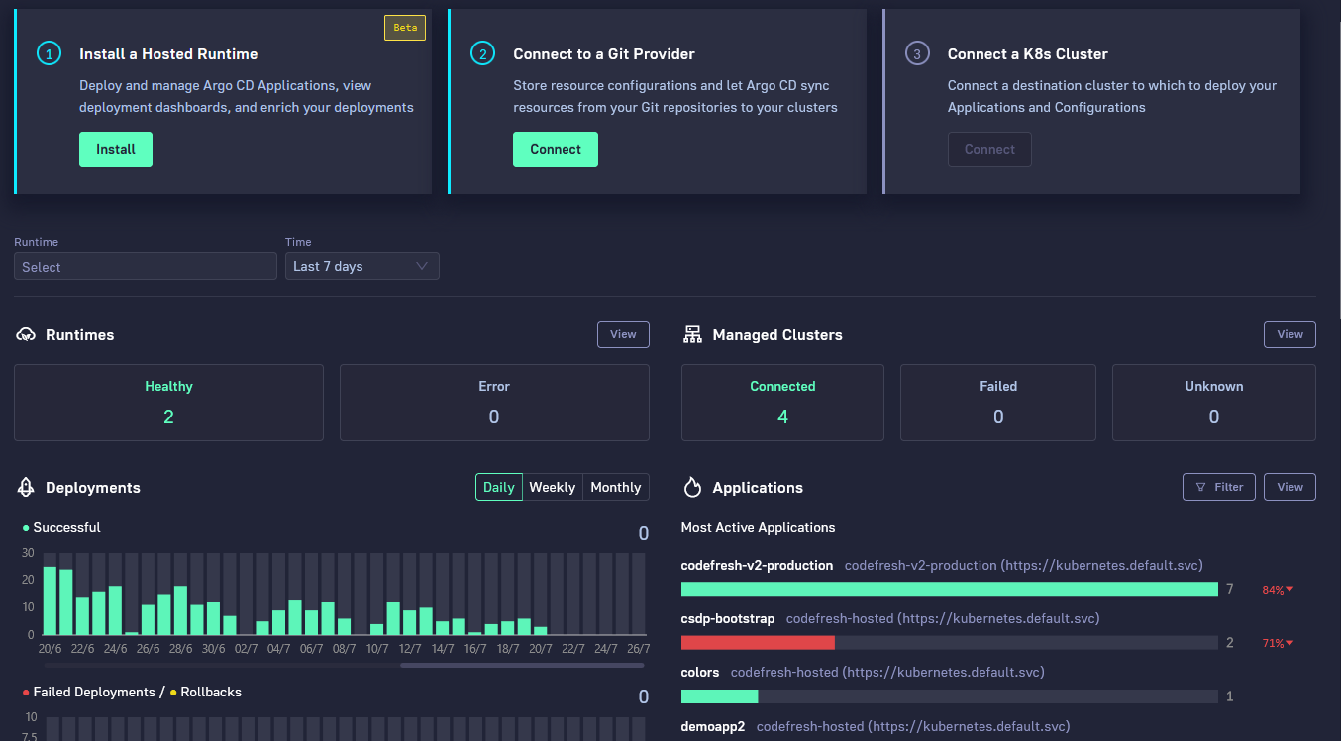
Notes:
Equivalent features - coming to CSDP soon

Slide 31
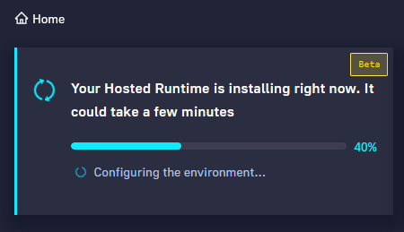
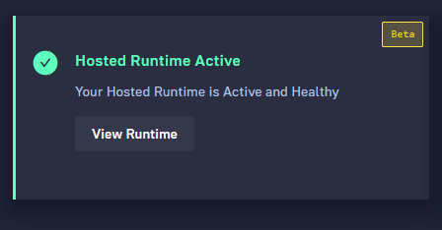
GUI abstracts everything
Notes:
Equivalent features - coming to CSDP soon

Slide 32
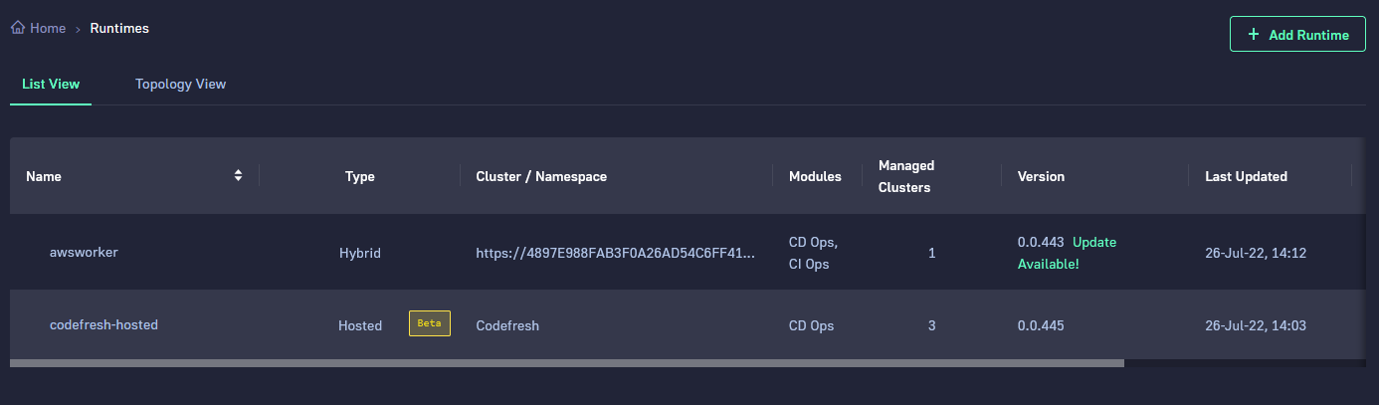
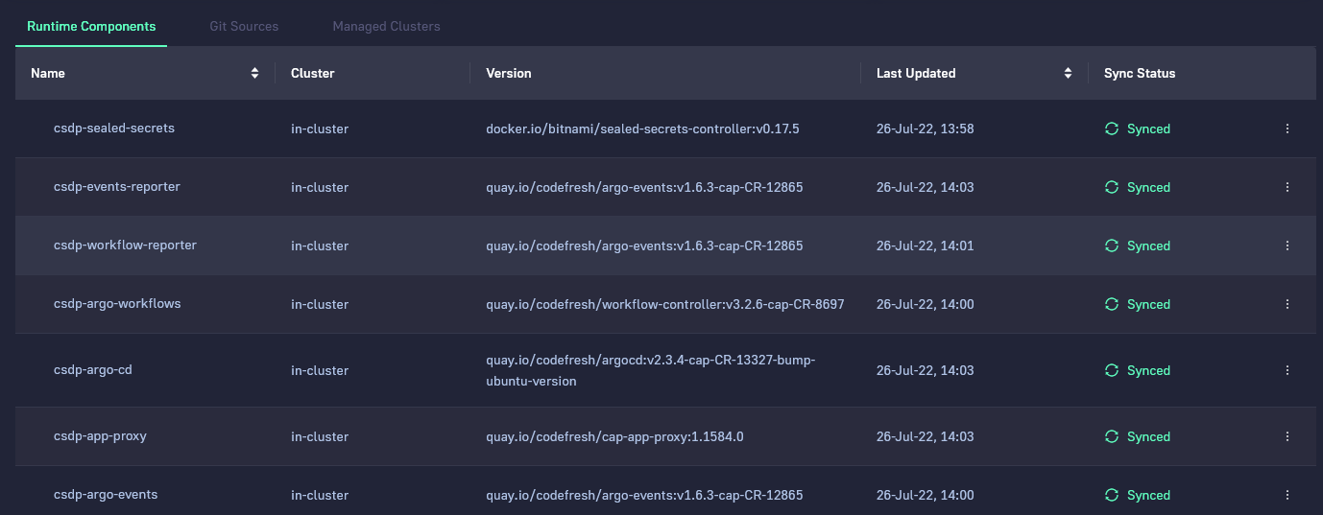
Notes:
Equivalent features - coming to CSDP soon

Slide 33
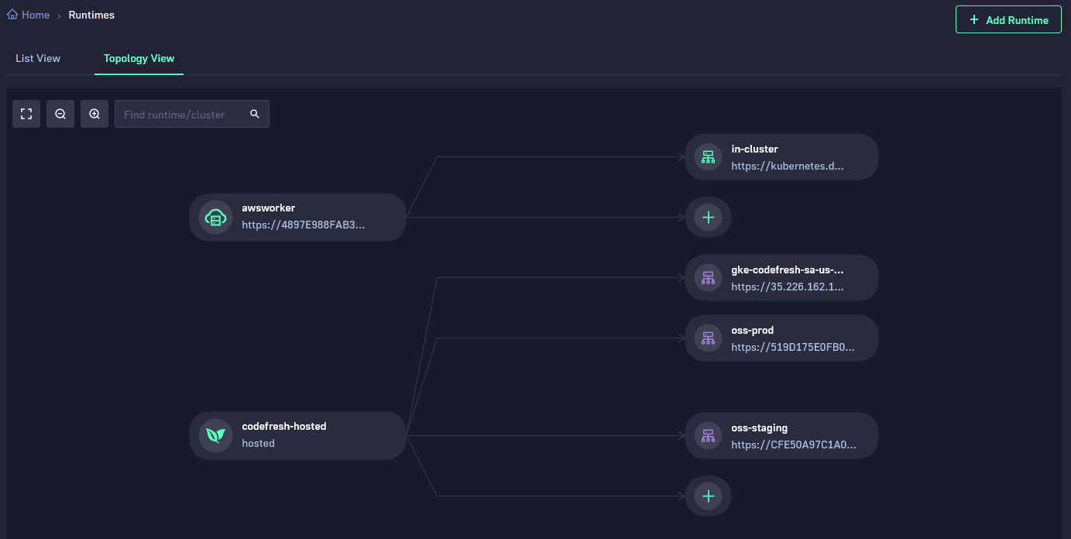
Connect Deployment clusters to ArgoCD/vcluster
Notes:
Equivalent features - coming to CSDP soon

Slide 34
Is it worth it?
Benefits

Slide 35

Benefits for users
Photo by Alex Block on Unsplash
Your own Argo CD instance on the cloud
One-click installation
(Almost) Instant setup
Zero configuration, zero maintenance
Flexibility on K8s/Argo CD version
Friendly management UI with optional SSO
Notes:
Equivalent features - coming to CSDP soon

Slide 36

Benefits for Codefresh
Centralized setup/monitoring
Security isolation
Cost effective/easy to scale
Resource sharing
Allow different combinations of K8s version/Argo CD version
Photo by Scott Blake on Unsplash
Notes:
Equivalent features - coming to CSDP soon

Slide 37
Monitoring
Since pods provisioned by workloads deployed on the vcluster are available on the host cluster API - we can use the same tools we use to monitor all other Kubernetes workloads.
In addition we built our own Prometheus exporter to monitor the hosted runtime health from the platform side
Notes:
Equivalent features - coming to CSDP soon

Slide 38
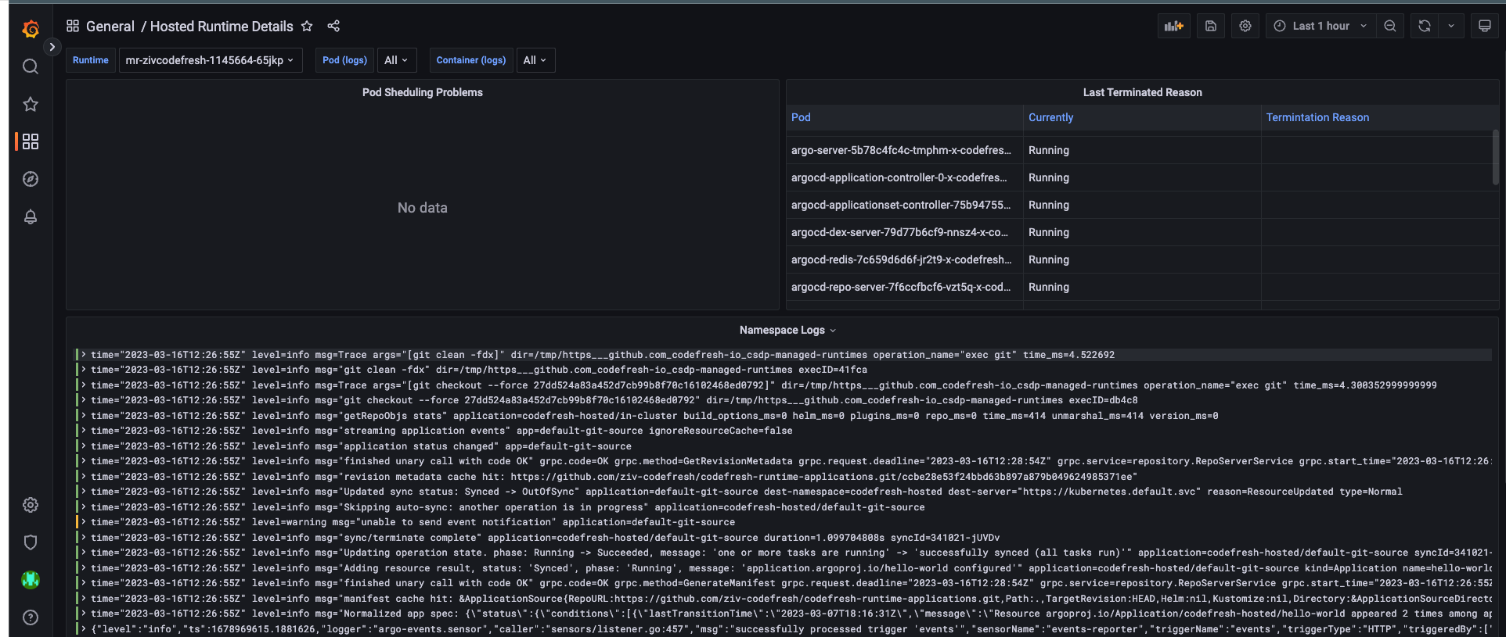


Notes:
Equivalent features - coming to CSDP soon

Slide 39
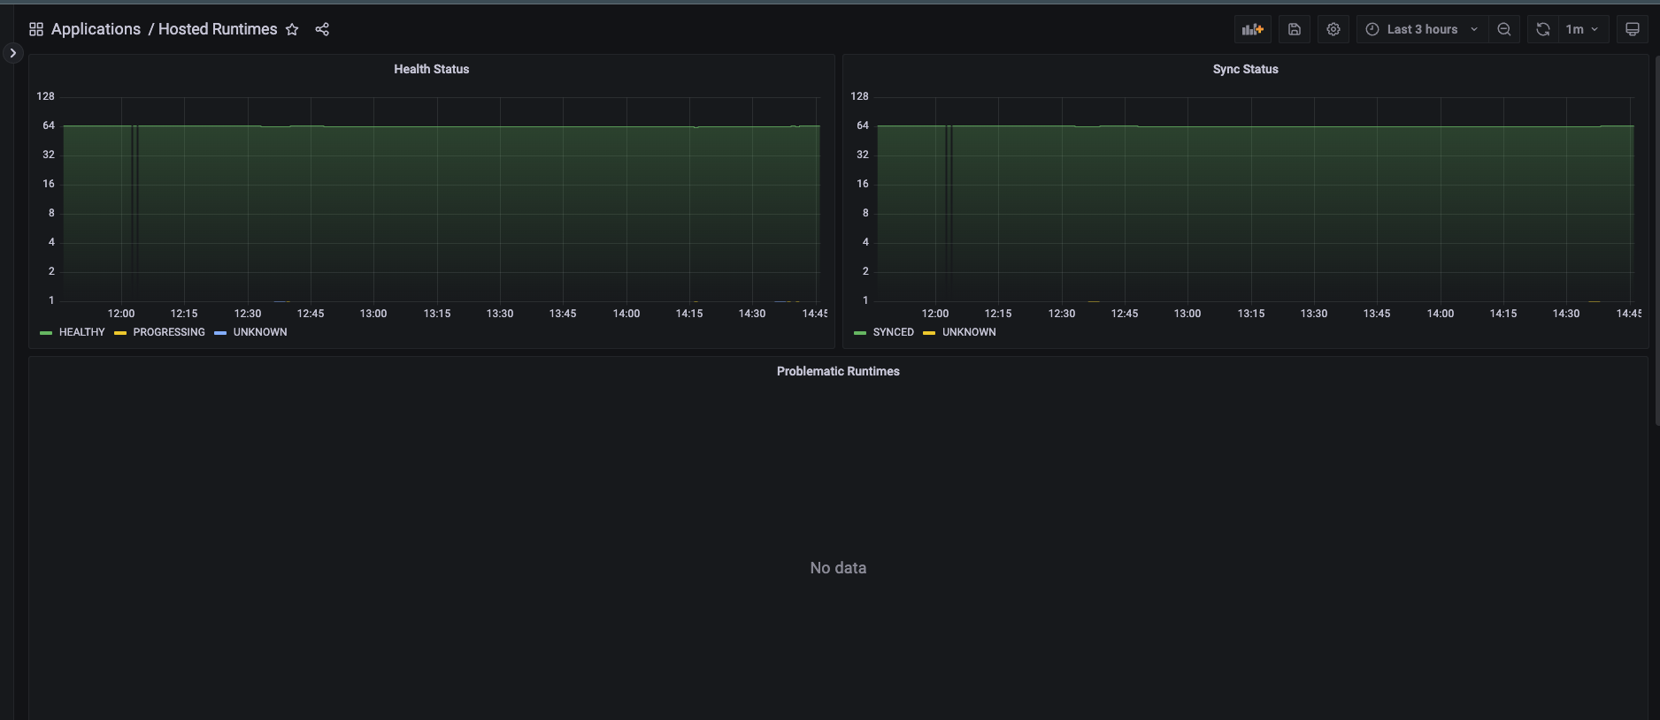
Platform custom exporter to aggregate data on all hosted runtimes health
Notes:
Equivalent features - coming to CSDP soon

Slide 40
See it in action
Demo time!
Provisioning and de-provisioning of hosted ArgoCD

Slide 41
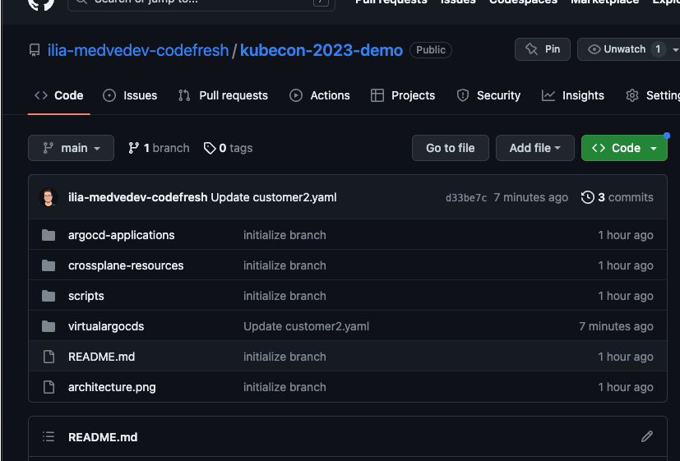

https://github.com/codefresh-contrib/kubecon-eu-2023-demo-crossplane-vcluster.git
Notes:
Equivalent features - coming to CSDP soon

Slide 42
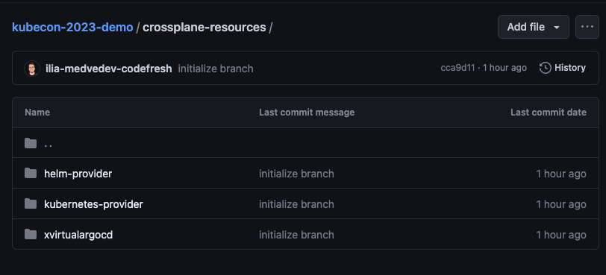
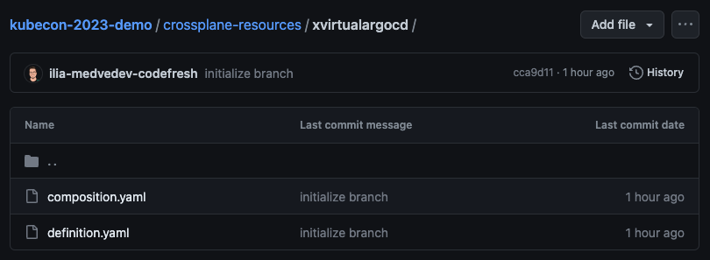
Notes:
Equivalent features - coming to CSDP soon

Slide 43
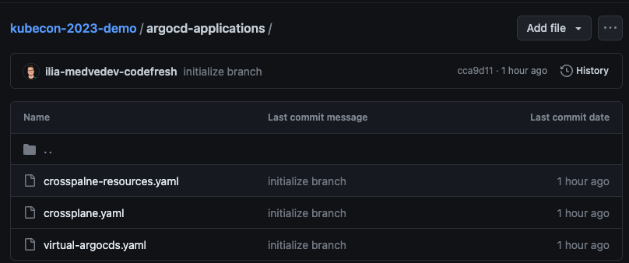
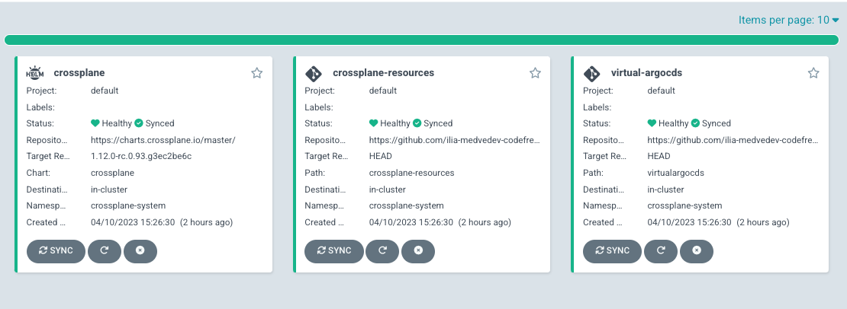
Crossplane official Helm chart
Notes:
Equivalent features - coming to CSDP soon

Slide 44
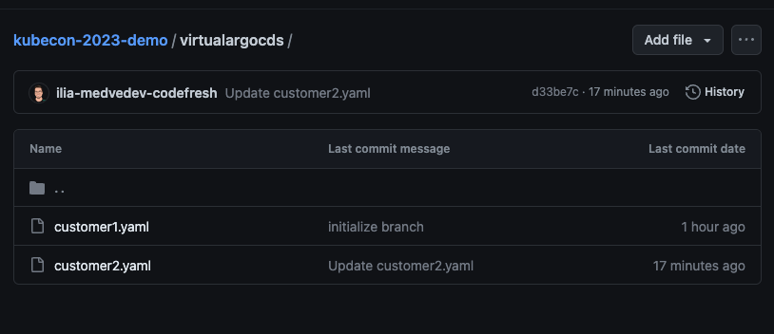
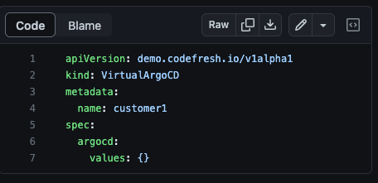
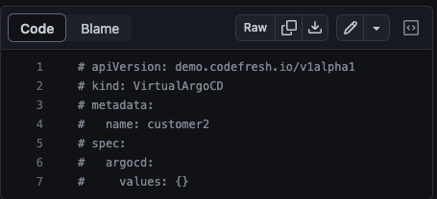
Notes:
Equivalent features - coming to CSDP soon

Slide 45
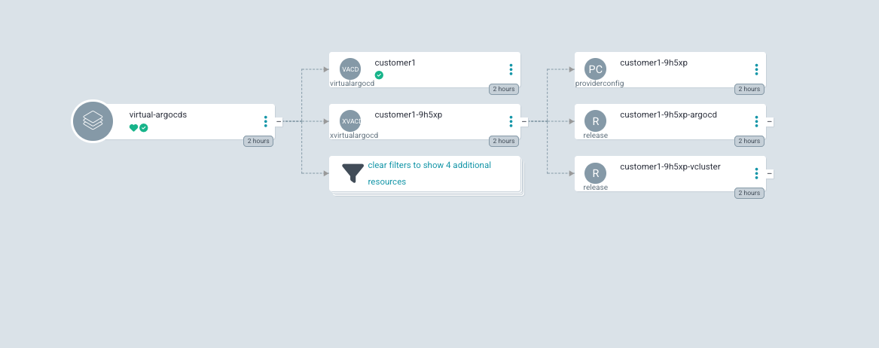
Helm ProviderConfig with vcluster credentials
Helm release - ArgoCD on vcluster
Helm release- vcluster (deployed on host)
Notes:
Equivalent features - coming to CSDP soon

Slide 46


Slide 47
Resources
vcluster.com (also loft.sh)
crossplane.io (also upbound.io)
codefresh.io
learning.codefresh.io (Argo CD certification)

Slide 48

Questions?
Scan QR and give us feedback please!

